Slide 1

CS 5710- Face Emotion Recognition With Machine Learning

Slide 2

Contributors
Name: Govind Tatiyal
Student ID: 700733003
Name: Sachin Beniwal
Student ID: 700741814
Name: Sri Ram Nimmalapudi
Student ID: 700740239
Name: Venkataguruswamy Godha
Student ID: 700740474

Slide 3

Contribution
Name: Govind Tatiyal
MLP Classifier
Name: Sachin Beniwal
Logistic Classifier
Name: Sri Ram Nimmalapudi
Gaussian NB Classifier
Name: Venkataguruswamy Godha
KNN Classifier

Slide 4

Motivation
Detection of human emotion is used in a variety of applications where additional security or information about the person is required.
It can be thought of as a second step after face detection, in which case we may be necessary to implement a second layer of security in which, in addition to the face, the mood of the person is identified.
This can be important for ensuring that the person standing in front of the camera is not merely a 2-dimensional image of themselves on the screen.
We will examine and contrast algorithms and feature extraction strategies from a variety of research papers.
The human emotion dataset can serve as an excellent case study for investigating the robustness and nature of classification algorithms, as well as how they function when applied to diverse types of datasets.

Slide 5
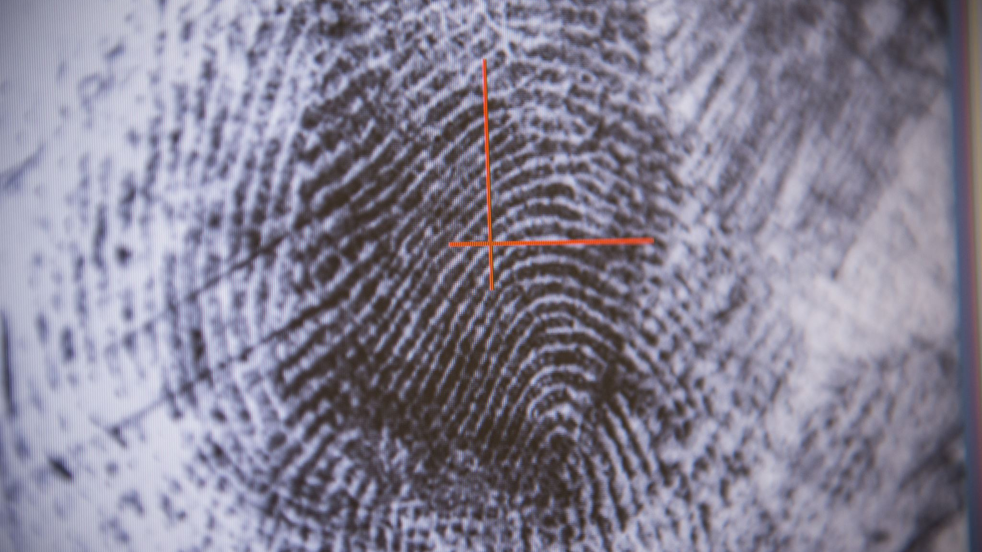
Objective
The most important and significant objective of this research is to identify various human expressions with the help of machine learning techniques and algorithms.
With the help of such techniques, we aim to reduce the error and recalls while predicting the facial expressions and increase the precision.
As a result of this, we have lesser probability to wrongly identify a mood and at the same time maximize the chances of correct predictions.
Facial emotion recognition is extremely useful in criminology and identifying related areas.
The applications also holds its significant place in medical, technology and armed forces services.

Slide 6
Related work
During the last decade, academics have become increasingly interested in facial expression recognition because of the numerous possible applications it provides.
Faces with expressions of happiness, surprise, disgust, sadness, anger, and terror Emotions are recognized using facial recognition software.
Face detection can be accomplished using a variety of approaches.

Slide 7
Problem Statement
Consumer research is not always as reliable as businesses wish and some people sugercoat their opinions.
emotion recognition technology enables businesses to elicit additional information from focus groups.
Businesses can evaluate the facial expressions of testers who are using their goods or watching their commands.

Slide 8
Proposed Solution
We developed three models for the analysis and prediction of emotions in this section. Each model has its own data preprocessing and so produces results with varying degrees of accuracy. The three models that we created are as follows:
Logistic Regression
K –Nearest Neighbor
Gaussian Naïve Bayes
Multilayer Perceptor

Slide 9
Different Models and their Results

Slide 10
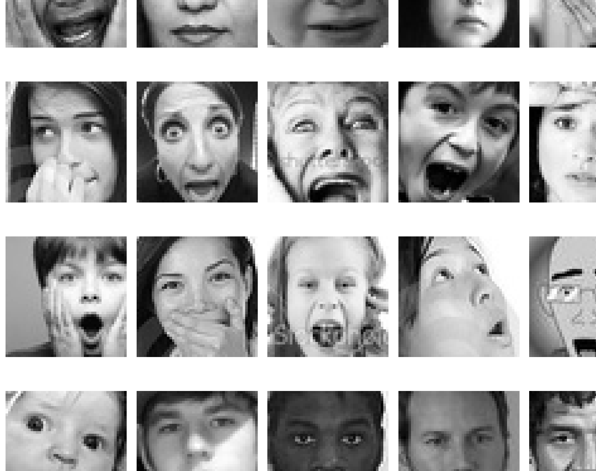
Various Expressions used in this model:

Slide 11
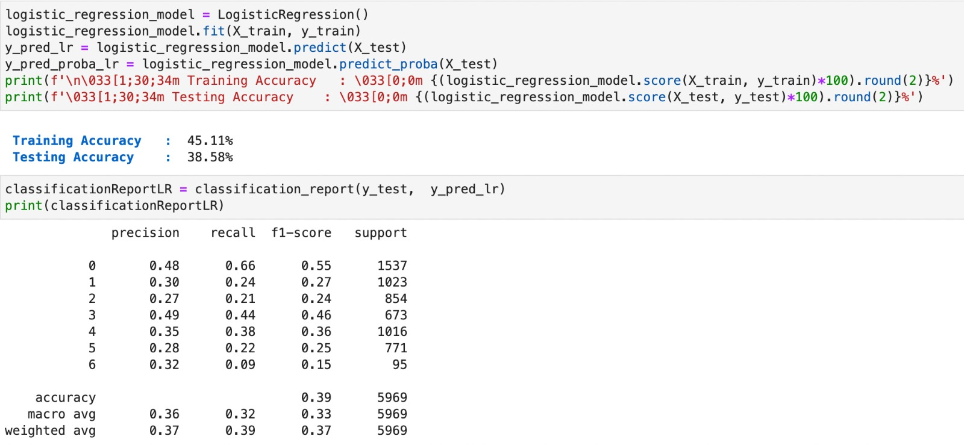
Logistic Regression

Slide 12
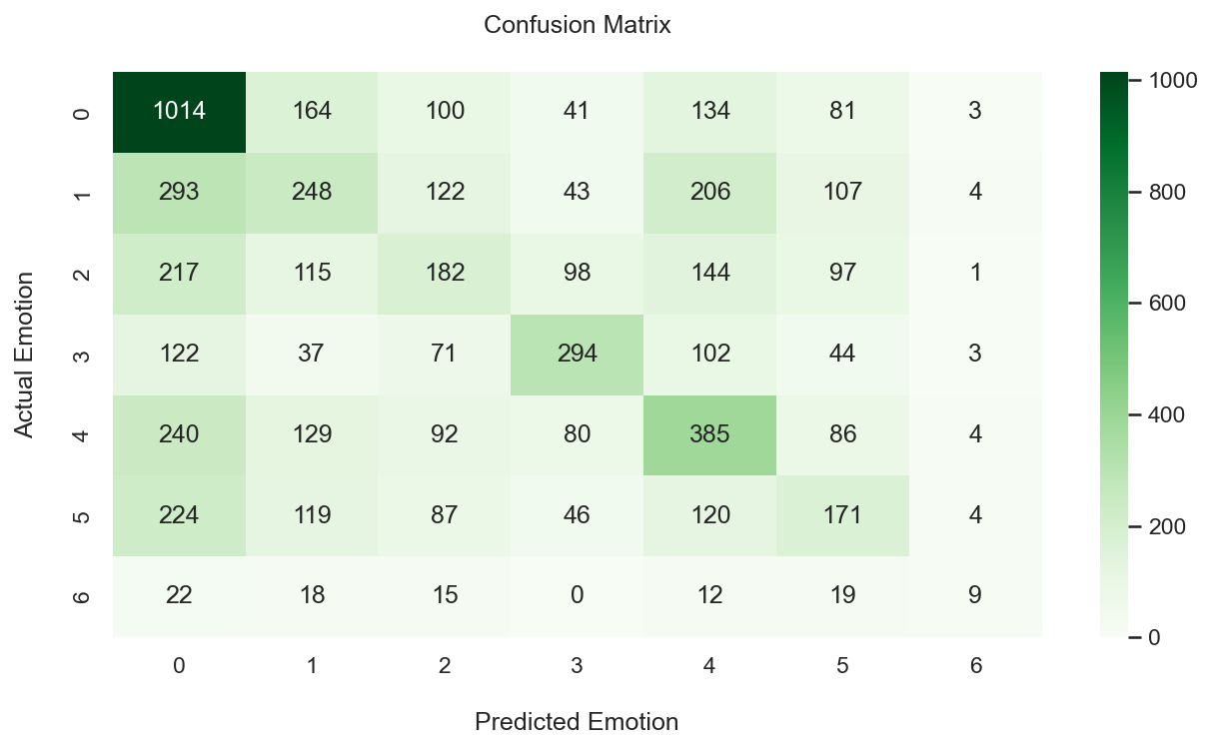

Slide 13
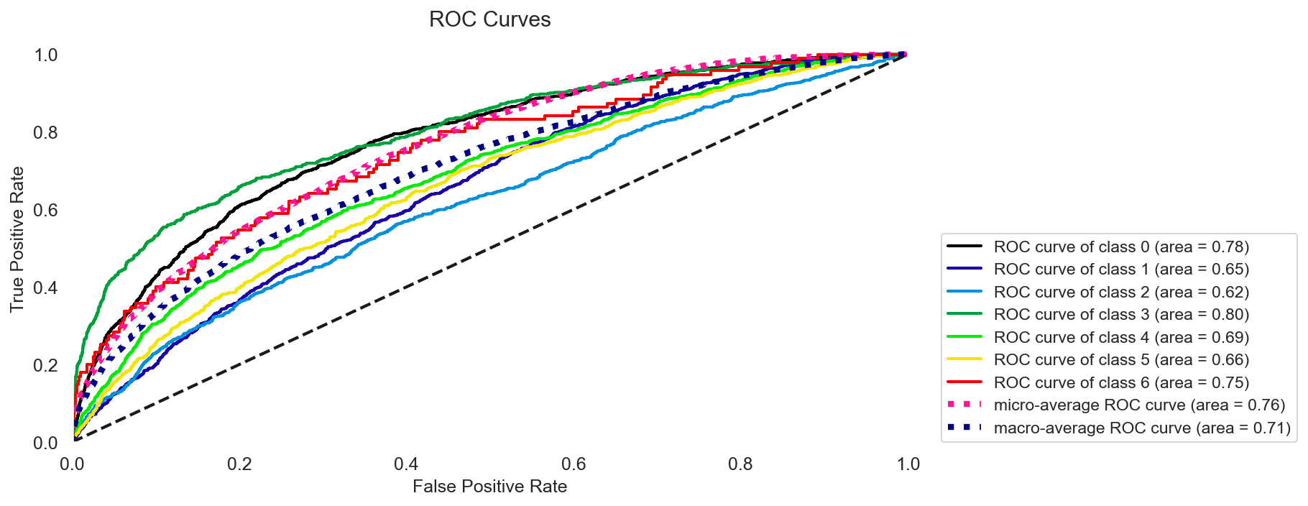

Slide 14
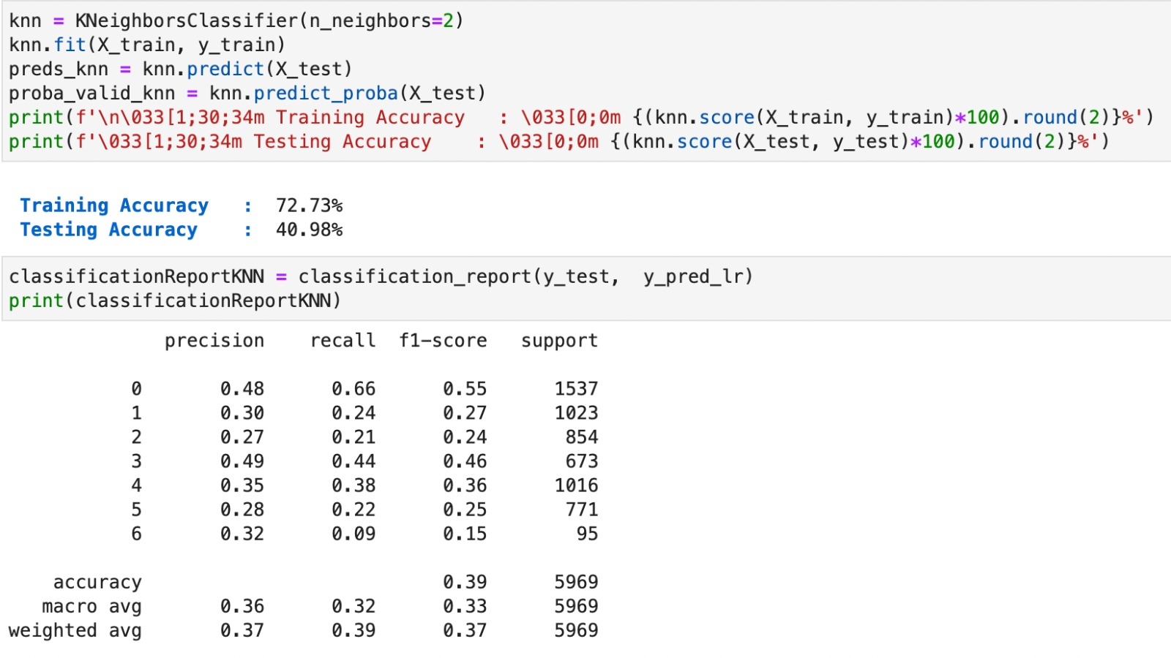
K-Neighbor Classifier

Slide 15
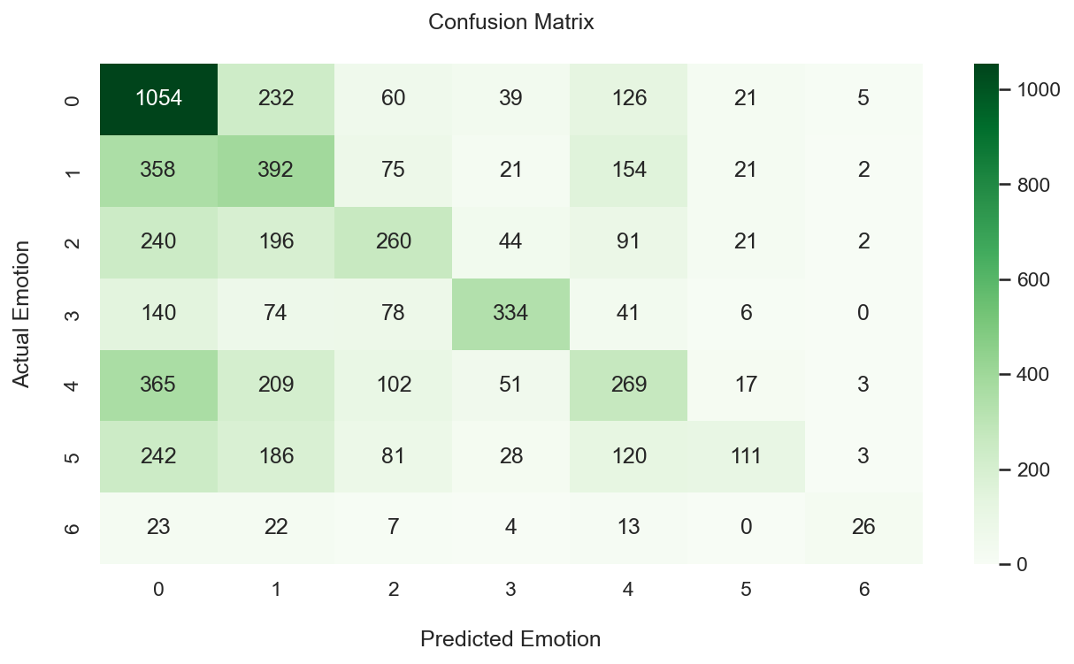

Slide 16
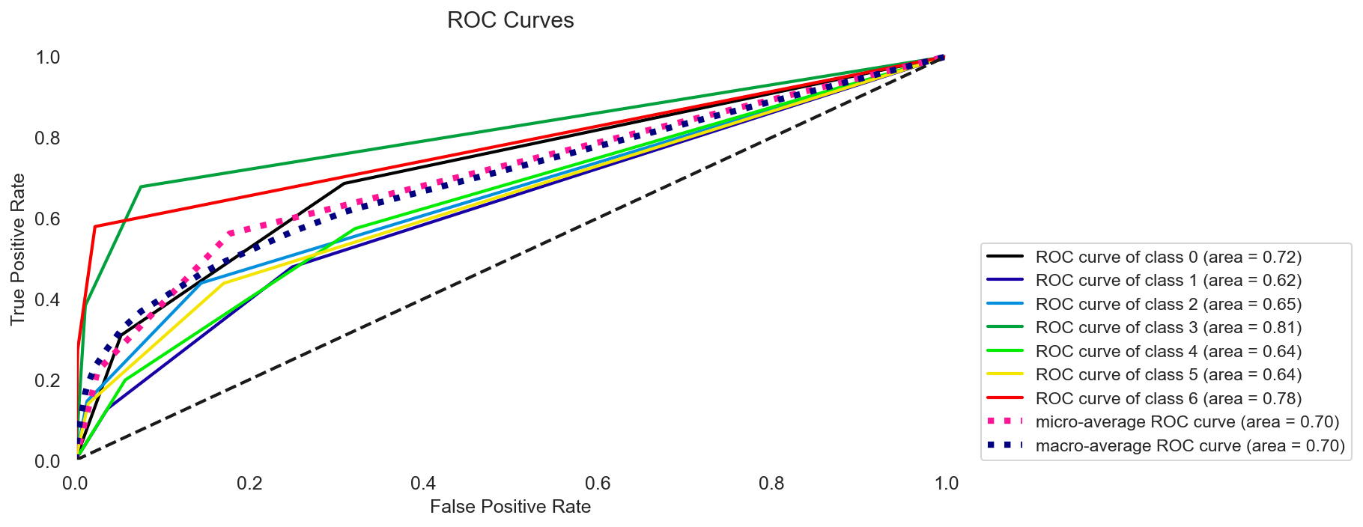

Slide 17
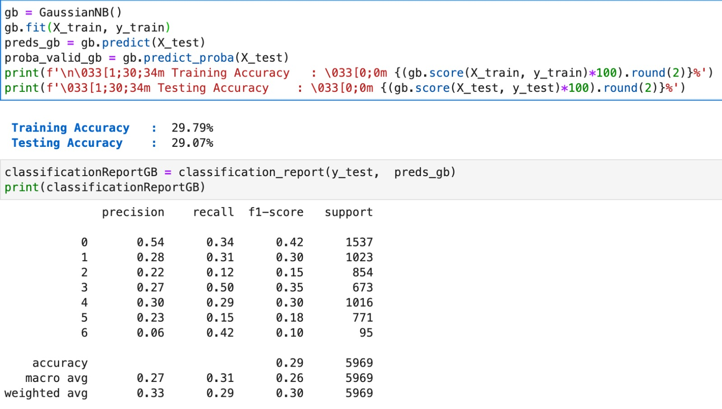
Gaussian NB Classifier

Slide 18
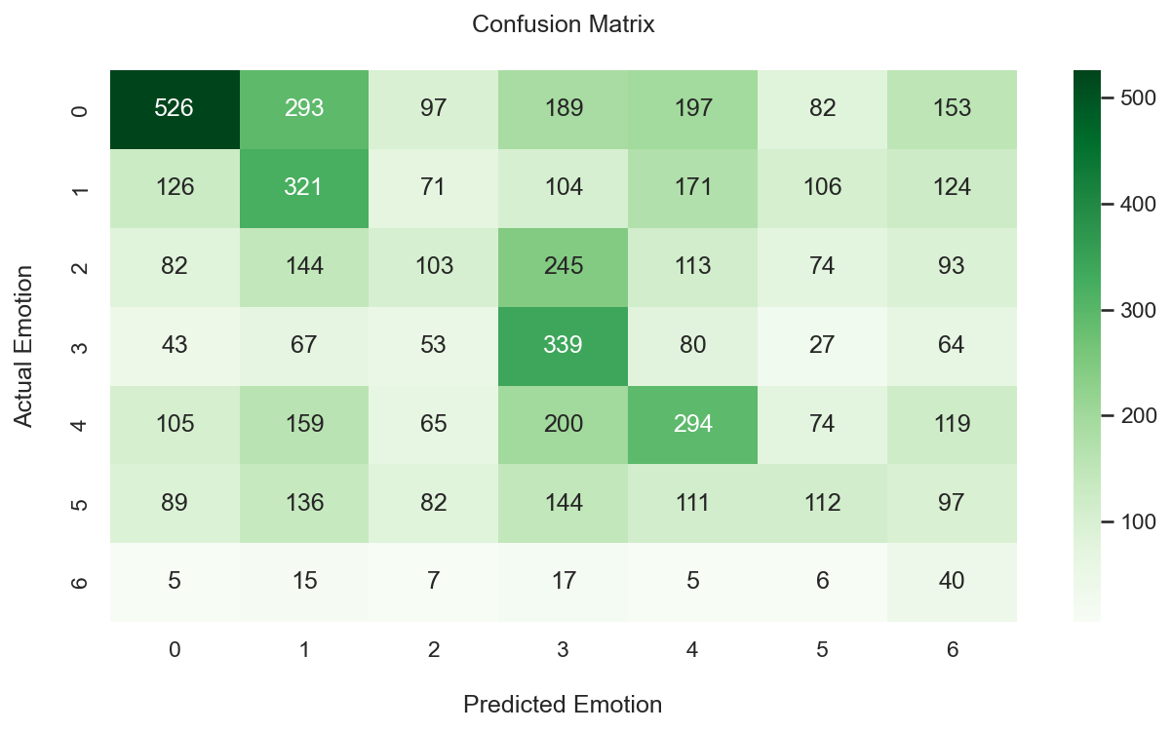

Slide 19
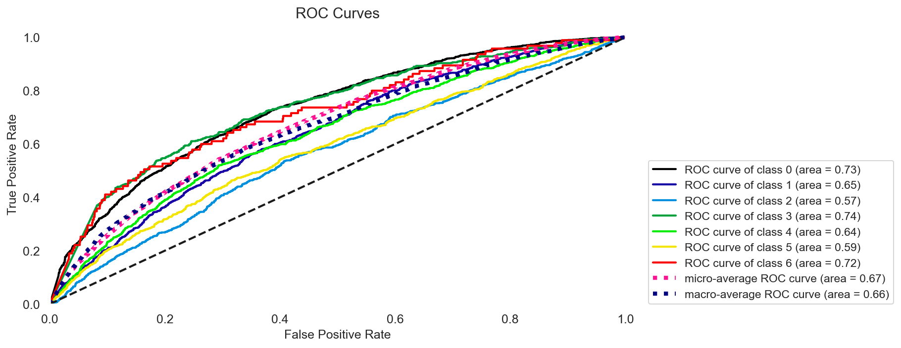

Slide 20
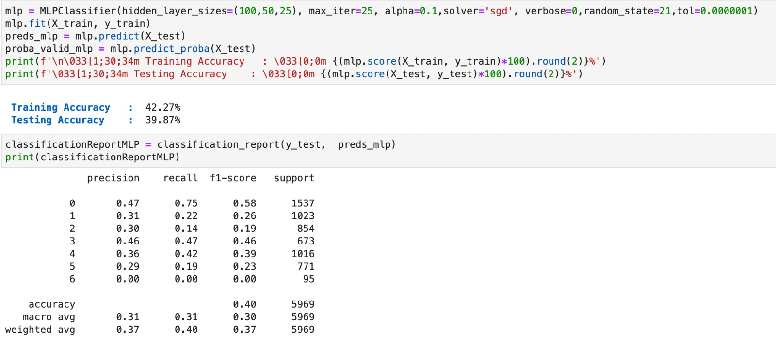
Multi Layer Perceptron Classifier

Slide 21
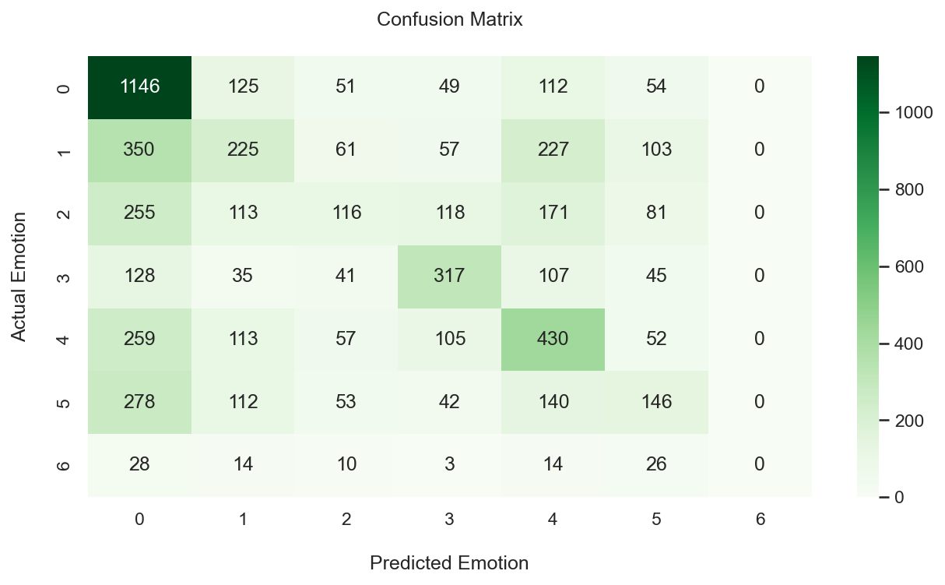

Slide 22
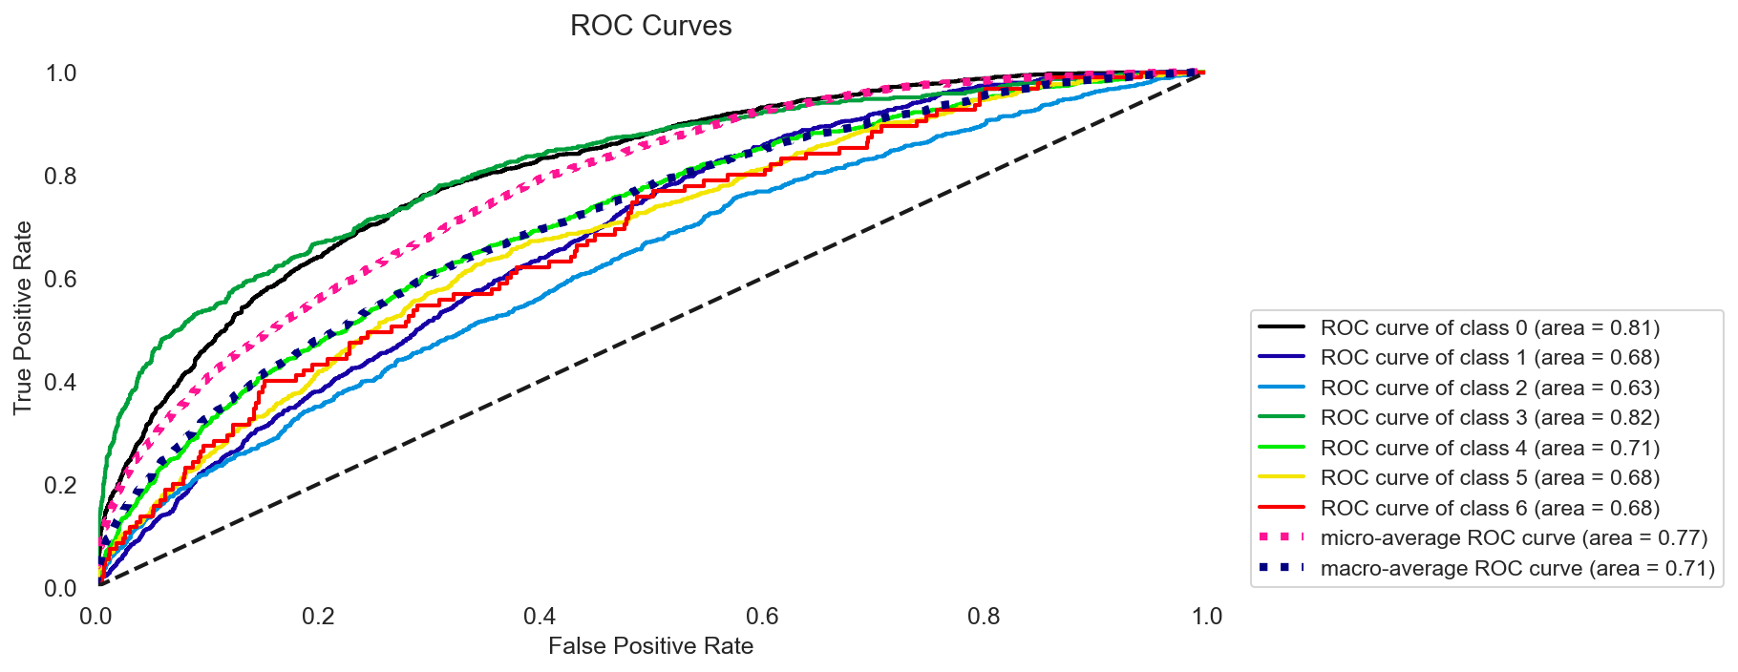

Slide 23
References
Balaji, B., Pranshu, D., Rajeshwar, N., & Anuradha, B. (2019). Analysis of Facial Emotion Recognition. IEEE 2019 3rd International Conference on Trends in Electronics and Informatics (ICOEI).
Sabrina, B., Ali, O. T., & Maaruf, A. (2020). Emotion Recognition Based on Facial Expressions Using Convolutional Neural Network (CNN). IEEE 2020 International Conference on Computing, Networking, Telecommunications & Engineering Sciences Applications (CoNTESA).
Shaug, l., Dahua, L., Qiang, G., & Yu, s. (2020). Facial Emotion Recognition Based on CNN. IEEE 2020 Chinese Automation Congress (CAC).
Shubhanjay, P., Sonakshi, H., & Yogesh. (2022). Facial Emotion Recognition using Deep Learning. IEEE 2022 International Mobile and Embedded Technology Conference (MECON).

Slide 24

Thank You

